Slide 1

Why do mirrors reverse right/left but not up/down?
The Journal of Philosophy by N.J.BLOCK

Slide 2
Interpretations
Interpretation | Question
Reading (R) | Why is it that while both the placard and its mirror image read up to down, the placard reads left to right while the mirror image of the placard reads right to left?
Getting into one’s portrait (G) | Why is it that when I get into my portrait it fits vis-a-vis top/bottom but fails to fit vis-'a-vis right/left?
Direction (D) | Why is it that, up of portrait is same direction as up for me while right for my image is same as left for me?
Wiggle (W) | Why is it that when I wiggle my right arm my mirror wiggles his left arm even though when I wiggle my head my image wiggles his head too?

Slide 3


Interpretation ’R’
EXAMPLES
R – Reading
Mirror and humans are stationary.
Placard is rotated
TYPE – 1
Input text
(read L- R)
TYPE – 2
Rotated along y- axis
Most common rotation
Read R-L
Rotated along x- axis
Reads D-U
Read R-L
Type 1
Type 2

Slide 4
Mirror seems to treat X, Y- axes differently in previous example.
Let’s take another example.
Input text
(read L- R)
Human Turns 180°
Most common rotation
Read R-L
Human Bends 180°
Reads D-U
Read R-L
Other example for Interpretation ‘R’
Placard, mirror are stationary.
Human rotates.
Type 1
Type 2

Slide 5
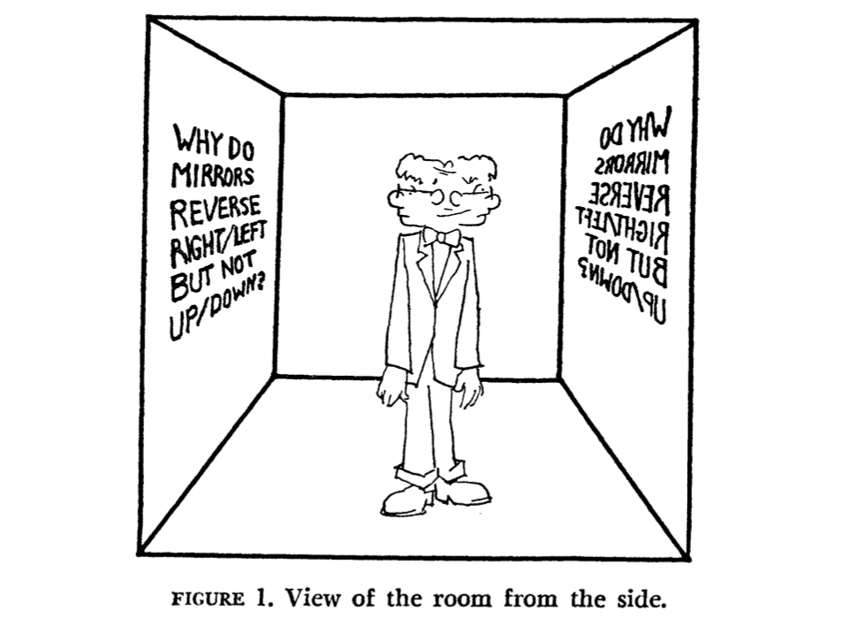
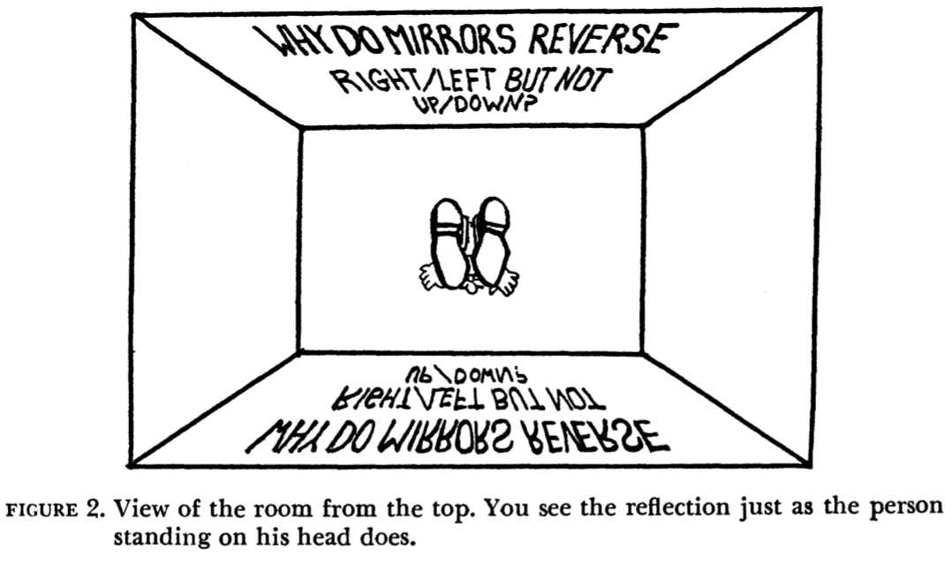
Examples
Source : The journal of philosophy

Slide 6
False Assumptions
For any text, there exist only one unique mirror image.
Take aways from Interpretation ‘R’
Mirror doesn’t treat the two axes differently. Human chooses which way to rotate (object or himself)
Depends on how or what has been rotated.

Slide 7
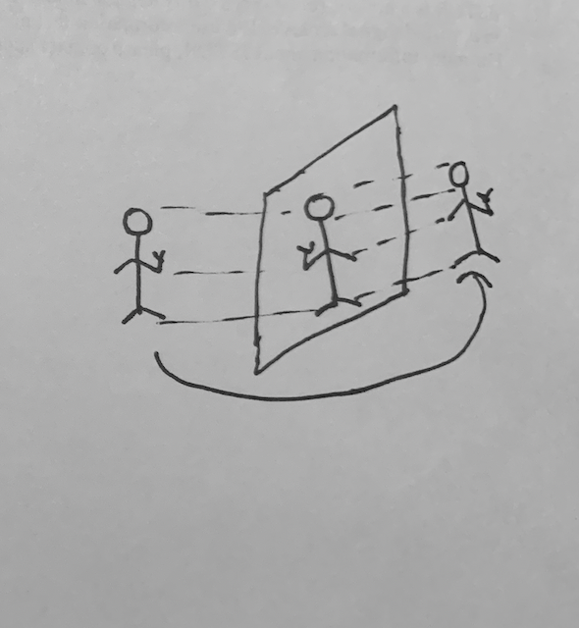
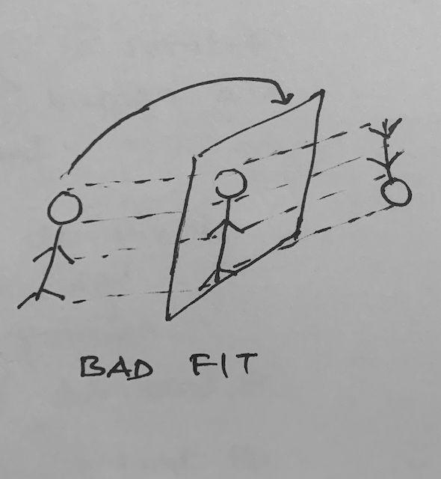
Interpretation ‘G’
D.F.pears – right/left reversal is illusory – “Incongruity of counterparts”
Look at the mirror -> portrait of mirror image -> go behind and face back of it.
Top/bottom –fits
Left/right – fails
Bad Fit – Due to Asymmetry
Bilateral Symmetry

Slide 8
Enantiomorphs
Asymmetrical object and its reflection cannot be made to coincide when one is superimposed on the other.

Slide 9
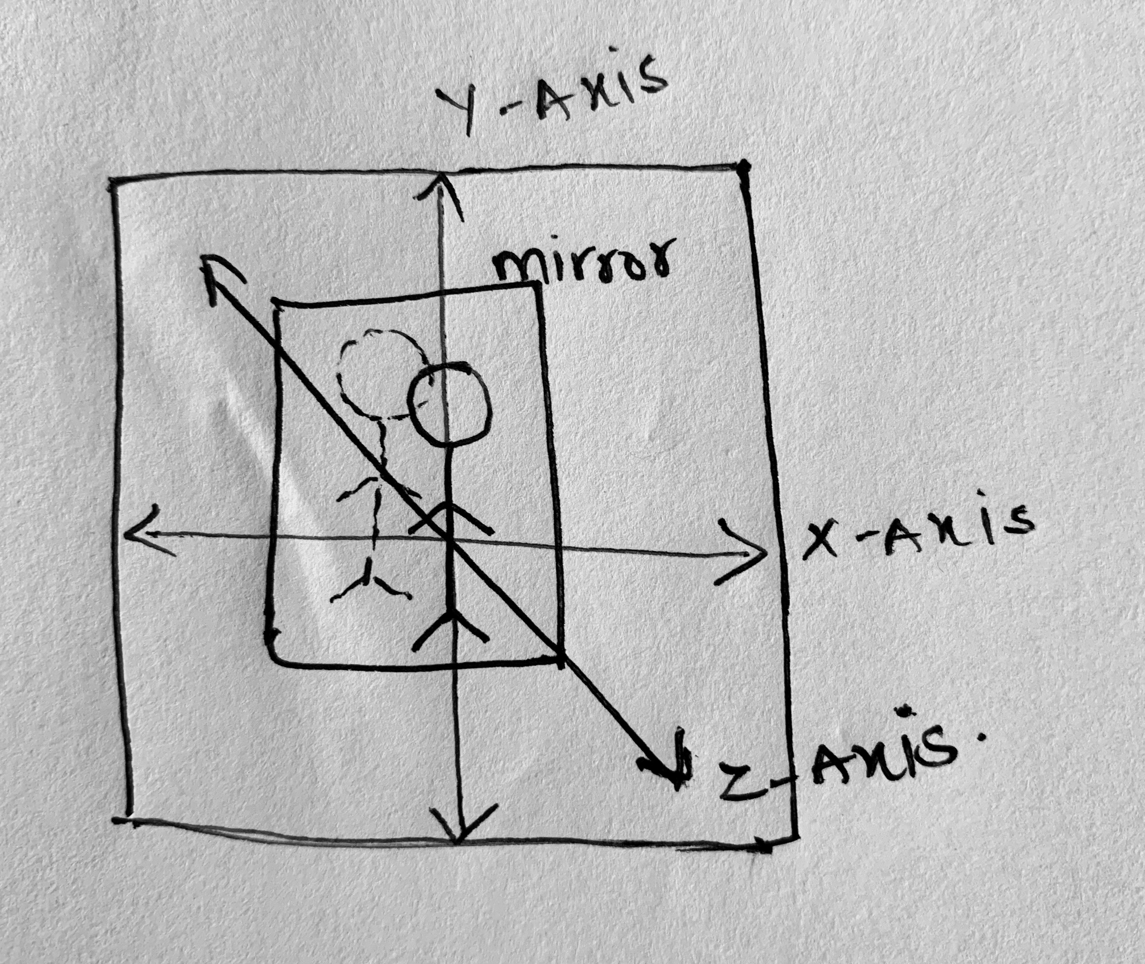
Interpretation ‘D’
Why is it that when I am facing my image in a mirror, up for my image is the same direction as up for me while right for my image is the same direction as left for me?
Can we solve this with Geometrical optics?
*No rotation. Unlike reversal(r) , reversal(g)

Slide 10
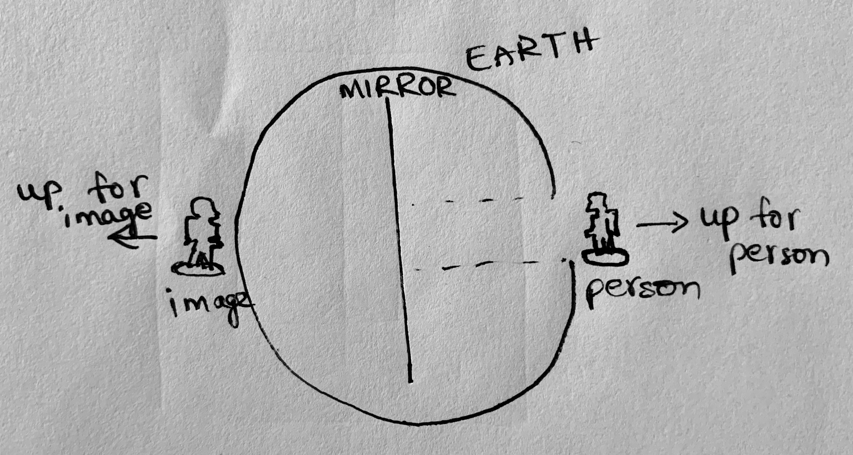
Geometrical optics??
No. Geometrical optics are used to understand how the image is produced. But our question is different
Suppose, define “up” w.r.t earth:
Away from the center of earth
How to define “right”??
Depends on orientation
Ends of X- axis are Right/Left.
Ends of Y- axis are Up/Down.
Ends of Z – axis are frontward/ backward.
Tip:
What are up, right?

Slide 11
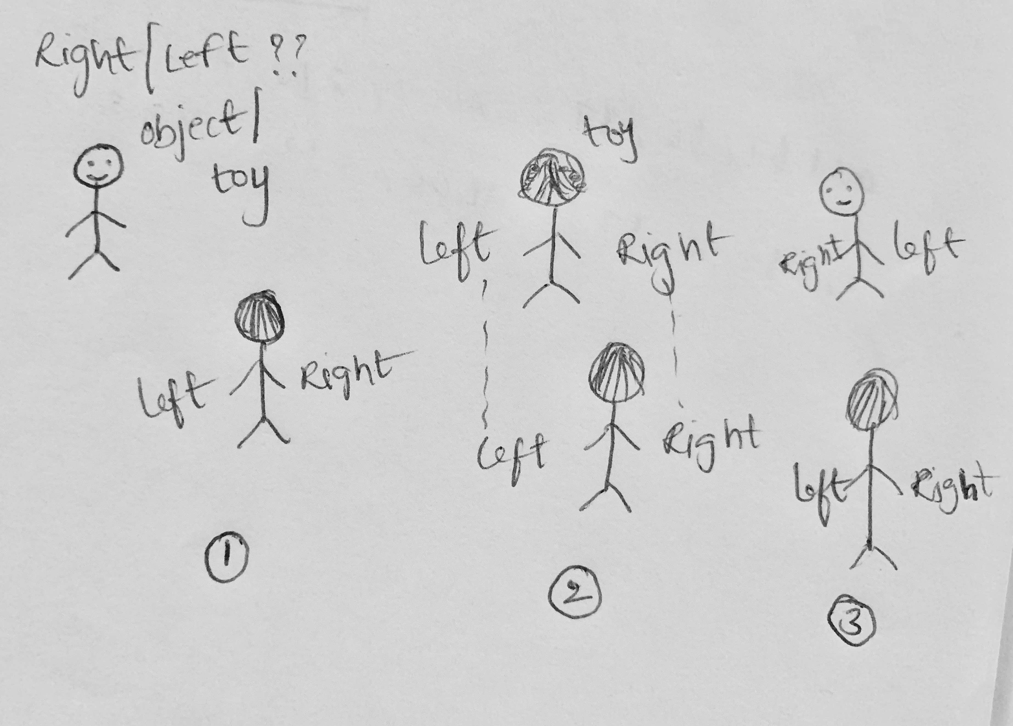
Object – clock
Case 1: one clock in the vicinity, sufficiently far away.
Case 2: two clock one above mirror and other behind the person.
How humans decide on right and left?
Many people use anatomical or behavioral symmetry

Slide 12
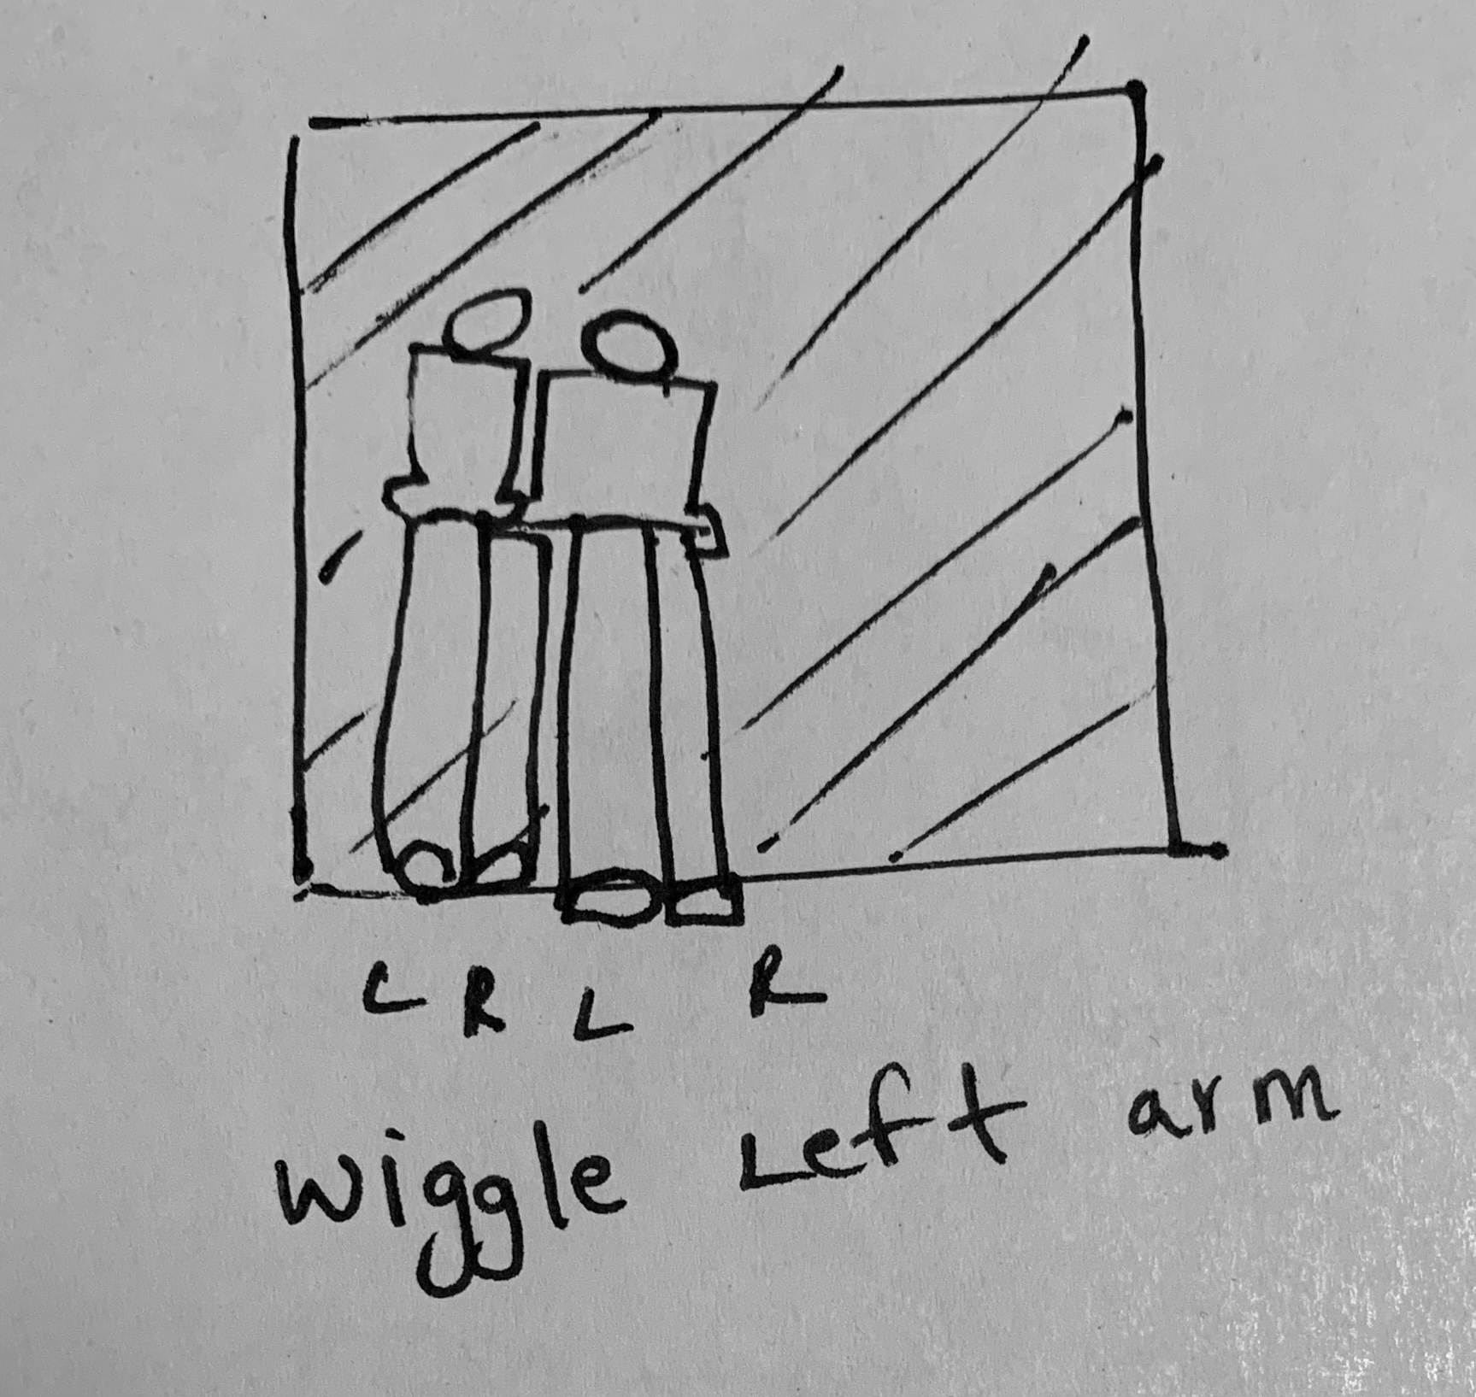
Interpretation ‘W’
Why is it that when I wiggle my right arm my mirror image wiggles his left arm even though when I wiggle my head my image wiggles his head and not his feet?
direction | definition
Human’ right | Rightward arm
Human’s left | Leftward arm
Image’s right | Opposite to Human’s left
Image’s left | Opposite to Human’s right
Image’s head | Opposite to Human’s head
Image’s up | Human’s up
Works only with flat mirrors/ curved mirrors with proper orientation

Slide 13
Conclusion
Reversal | working
Reversal r | The mirror reverses(r) the object x/y= The object reads y to x while the mirror image of the object reads x to y.
Reversal g | The mirror reverses(g) me x/y= When I get into my portrait it fails to fit vis-à-vis x/y
Reversal D | The mirror reverses(d) x/y= The direction that is x for my image is the direction that is y for me and vice versa
Reversal W | The mirror reverses(w) me x/y= When I wiggle my x part my image wiggles his y part and vice versa

Slide 14
More papers on Mirrors
Much ado with mirrors by Michael : https://link.springer.com/content/pdf/10.3758/BF03210736.pdf
The relationship between the real body and mirror image by Ivana bianchi, ugo svardi : https://www.researchgate.net/publication/5246150_The_Relationship_Perceived_between_the_Real_Body_and_the_Mirror_Image

Slide 15
Thank you!!

